Slide 1


Kenyatta Hospital Child Immunization Tracking System
Introducing the Kenyatta Hospital Child Immunization Tracking System - a digital solution to improve Kenya's vaccination coverage and promote healthy futures.
by Jackson Mwadia Maghanga

Slide 2
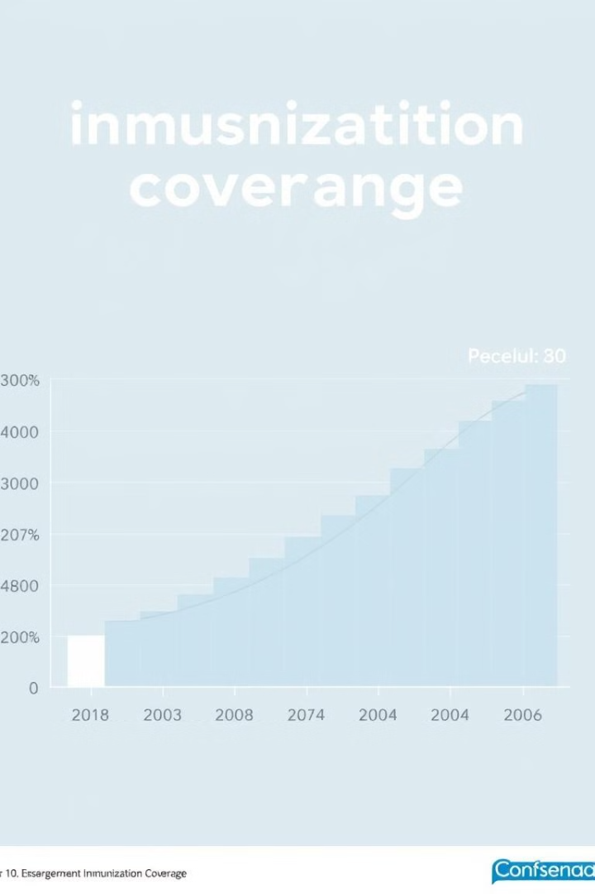
The Challenge: A Stagnant Immunization Landscape
1
Coverage Stagnation
Despite efforts, Kenya's immunization coverage has stalled at 80%, leaving many children vulnerable to preventable diseases.
2
Inefficient Tracking
Manual systems relying on paper booklets are prone to data loss, forgotten appointments, and delays in record-keeping.
3
Limited Data Visibility
The lack of a centralized system hinders real-time monitoring and informed decision-making by the Ministry of Health.

Slide 3
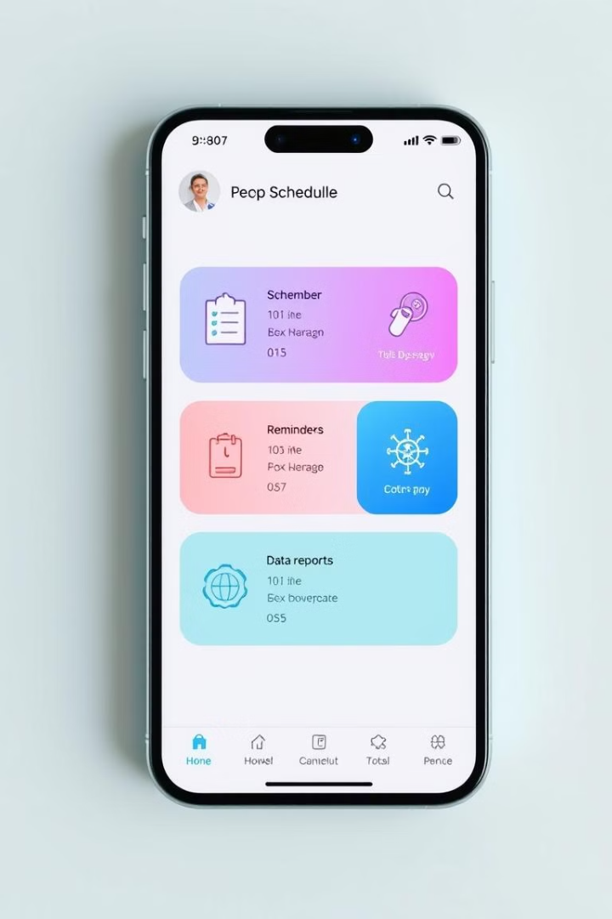
Our Solution: A Digital Transformation
Digital Immunization Booklets
The system digitizes immunization records, making them accessible anytime, anywhere, for both parents and healthcare workers.
Automated Reminders
Parents receive timely notifications about upcoming vaccinations, reducing missed appointments and improving vaccination coverage.
Data-Driven Insights
The system generates comprehensive reports on vaccination coverage, birth rates, and trends, empowering the Ministry of Health to make informed decisions.

Slide 4
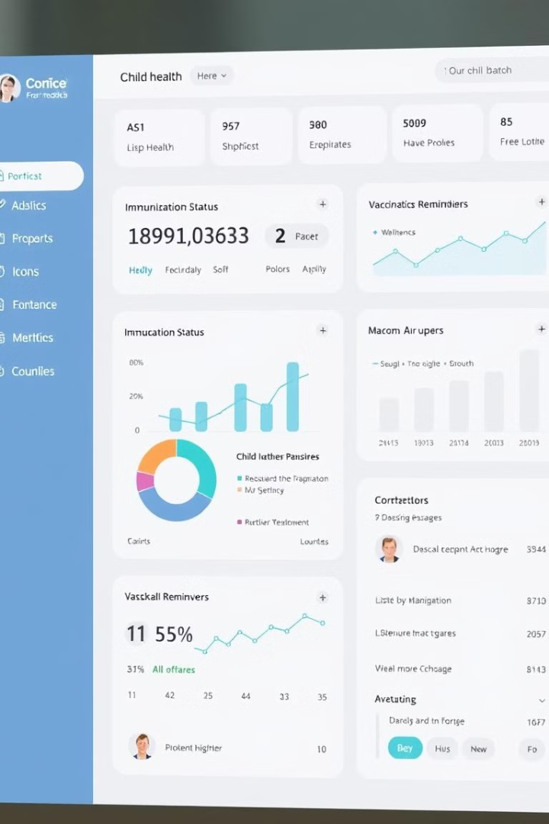
A Comprehensive Platform for Child Immunization
1
Child and Parent Registration
Secure registration of children and their parents, enabling easy access to immunization data.
2
Vaccination Scheduling
Automated scheduling of vaccines based on national guidelines, ensuring timely immunizations for every child.
3
Data Retrieval and Tracking
Comprehensive record-keeping for each child, allowing healthcare professionals to monitor immunization history.
4
Analytics and Reports
Detailed reports on immunization coverage, birth rates, and trends, providing insights into program effectiveness.

Slide 5
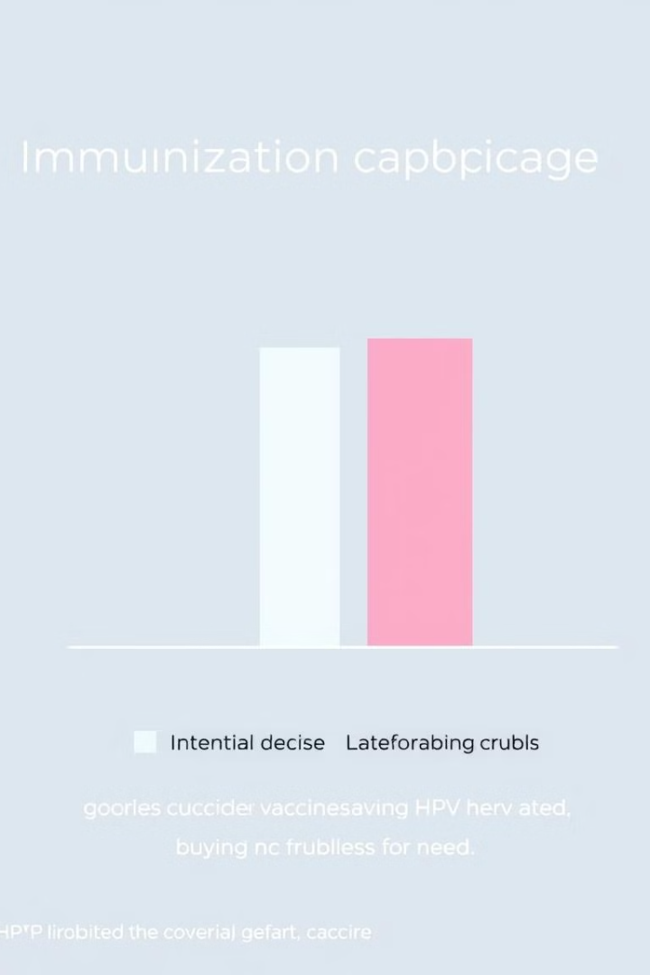
The Gravity of the Situation: A Call to Action
Vaccine
Coverage
HPV
30%
Measles-Rubella (2nd Dose)
50%

Slide 6




Reaching Our Target Audience: Empowering Stakeholders
Parents
Receive timely reminders, easily access immunization records, and stay informed about their child's health.
Healthcare Workers
Benefit from efficient data entry, automated reminders, and access to comprehensive vaccination histories.
Ministry of Health
Gain real-time insights into immunization coverage, identify trends, and make data-driven decisions to improve public health.

Slide 7
Benchmarking Excellence: Learning from Leading Systems
VaxTrac (Sierra Leone)
Australian Immunization Register
Kansas Immunization Registry
A comprehensive immunization system that has significantly improved vaccination coverage.
A national registry that provides real-time data on vaccination status and helps manage vaccine supply.
A state-level registry that enhances data accuracy, improves vaccine safety, and facilitates disease surveillance.

Slide 8
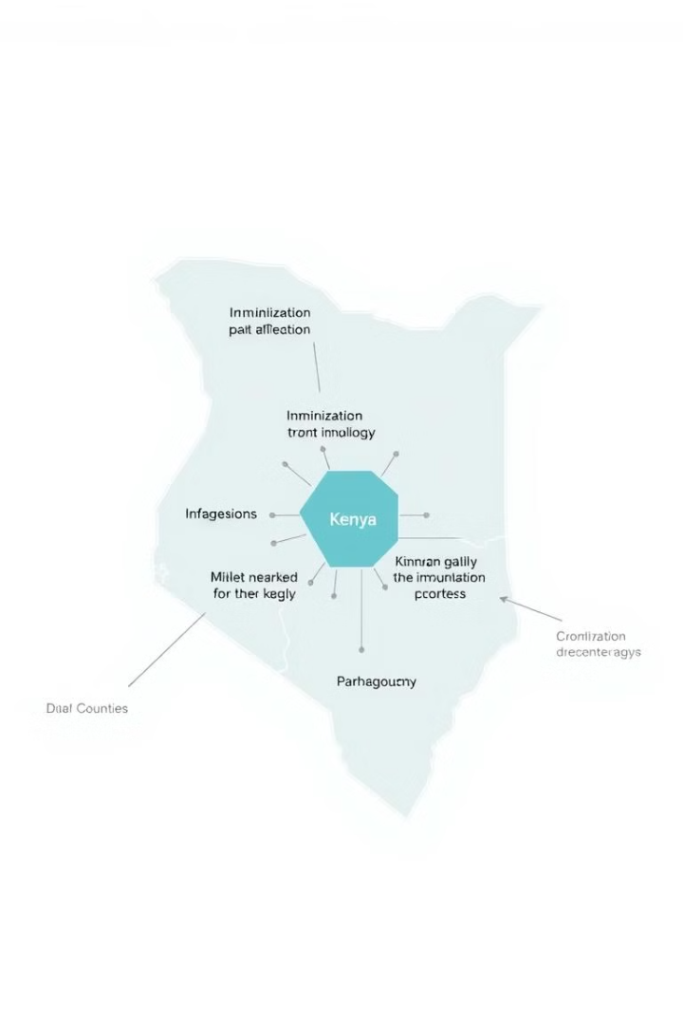




A Unique Advantage: Tailored to Kenya's Needs
Real-time Data Tracking
Ensures timely updates on immunization status, enabling efficient management of vaccine supply and distribution.
Automated Reminders
Promotes adherence to vaccination schedules, minimizing missed opportunities and maximizing vaccine efficacy.
Integrated Growth Tracking
Provides a holistic view of child health, allowing healthcare professionals to monitor growth and identify potential issues early on.
Centralized Access
Empowers parents, doctors, and MOH officials with a unified platform to access vital information and collaborate effectively.

Slide 9
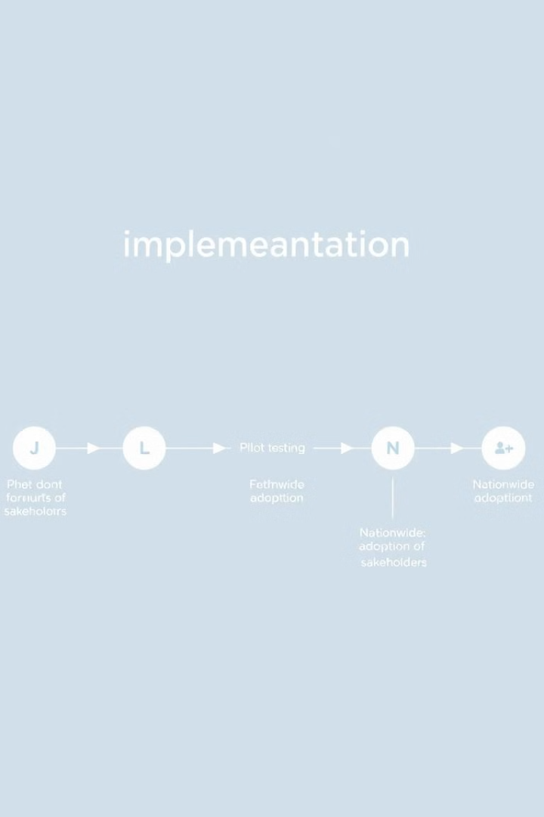
A Strategic Rollout for Impactful Change
Pilot Launch at Kenyatta Hospital
Initial implementation at Kenyatta Hospital, a leading referral hospital in Kenya, to test and refine the system.
Ministry of Health Partnership
Collaboration with the Ministry of Health to ensure seamless integration with existing healthcare systems.
Community Awareness Campaigns
Public awareness campaigns to educate parents and communities about the benefits of digital immunization tracking.

Slide 10



Making a Difference: A Legacy of Health and Well-being
Protecting Our Children
Reduces childhood mortality and improves health outcomes for generations to come.
Advancing Sustainable Development
Contributes to achieving SDG Goal 3: Good Health and Well-being, promoting a healthier and more equitable society.

Slide 11

Business Model
Government Grants
Subscription Services
Partnerships
Supporting healthcare innovation.
Private clinics access advanced tools.
Expanding reach with international organizations.

Slide 12
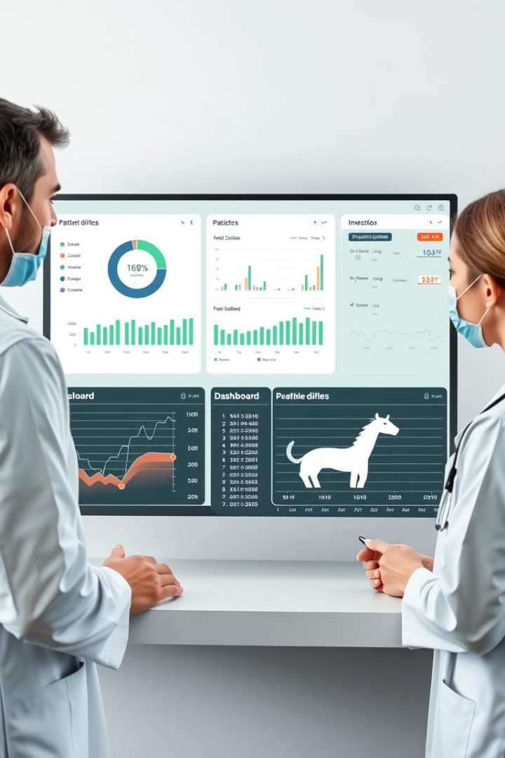
Project Traction
1
System Design
Completed and ready for implementation.
2
Pilot Program
Testing at Kenyatta Hospital, pending approval.
3
Scaling Up
Expanding to other hospitals nationwide.

Slide 13

Our Ask
1
Funding
2
Partnerships
Supporting scaling, server costs, and development.
Collaboration with hospitals and health organizations.

Slide 14

Team Members
Developer
Jackson Mwadia Maghanga
Supervisor
Power Learn Project Team

Slide 15

Contact Information
For more information, contact:
Email: mwadiajackson@gmail.com
Tel: +254746552127
THANK YOU

